Slide 1
Memory Hierarchies
Courtesy: Prof. Mats Brorsson, KTH, Sweden

Slide 2
Contents
Memory
DRAM
Caches
Memory Management

Slide 3
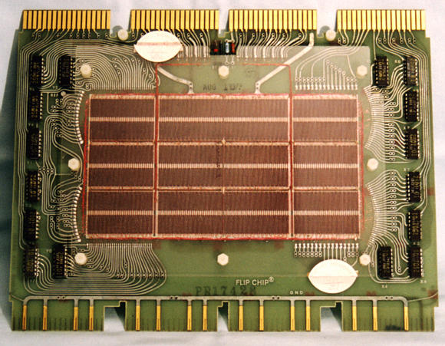
Core Memory
Core memory was first large scale reliable main memory
Invented by Forrester in late 40s/early 50s at MIT for Whirlwind project
Bits stored as magnetization polarity on small ferrite cores threaded onto two-dimensional grid of wires
Coincident current pulses on X and Y wires would write cell and also sense original state (destructive reads)
Robust, non-volatile storage
Used on space shuttle computers until recently
Cores threaded onto wires by hand (25 billion a year at peak production)
Core access time ~ 1μs
Core memory: DEC PDP-8/E Board,
4K words x 12 bits, (1968)
Notes:
Early machines had things like mercury delay lines (jse)
Photo from David Gesswein djg@pdp8.net

Slide 4

State of the art SSD
Samsung 990 PRO
Capacity 4TB
Sequential read
4TB: Up to 7,450 MB/s
Sequential write
4TB: Up to 6,900 MB/s
Source: https://semiconductor.samsung.com/consumer-storage/internal-ssd/990-pro/

Slide 5
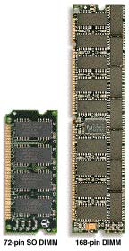
DRAM (Laptops/Desktops/Servers)
~7
Clock and control signals
DRAM chip
Address lines multiplexed row/column address
~12
Data bus
(4b,8b,16b,32b)
DIMM (Dual Inline Memory Module) contains multiple chips with clock/control/address signals connected in parallel (sometimes need buffers to drive signals to all chips)
Data pins work together to return wide word (e.g., 64-bit data bus using 16x4-bit parts)

Slide 6
DRAM Architecture
bit lines
Col.
1
Col. 2^{M}
word lines
Row 1
N
Row Address Decoder
Row 2^{N}
Memory cell (one bit)
N+M
M
Column Decoder & Sense Amplifiers
Data
D
Bits stored in 2-dimensional arrays on chip
Modern chips have around 4-8 logical banks on each chip
each logical bank physically implemented as many smaller arrays

Slide 7
DRAM Operation
Three steps in read/write access to a given bank
Row access (RAS)
Decode row address, enable addressed row (often multiple Kbytes in a row)
Bit-lines share charge with storage cell
Small change in voltage detected by sense amplifiers which latch whole row of bits
Sense amplifiers drive bit-lines full rail to recharge storage cells
Column access (CAS)
Decode column address to select small number of sense amplifier latches (4, 8, 16, or 32 bits depending on DRAM package)
On read, send latched bits out to chip pins
On write, charge sense amplifier latches which then charge storage cells to required value
Can perform multiple column accesses on same row without another row access (burst mode)
Pre-charge
Charges bit lines to known value, required before next row access
Each step has a latency of around 15-20ns in modern DRAMs
Various DRAM standards (DDR, RDRAM) have different ways of encoding the signals for transmission to the DRAM, but all share same core architecture
Notes:
Use RAS/CAS to reduce average latency.

Slide 8
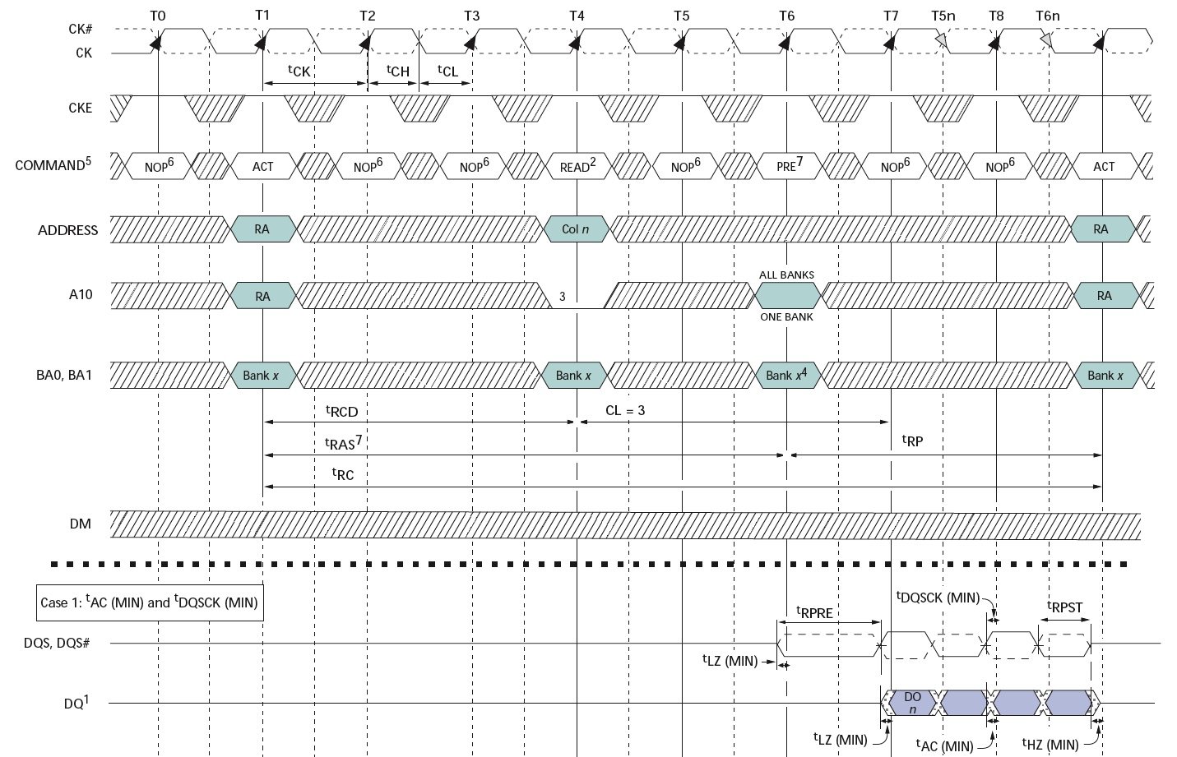
Double-Data Rate (DDR2) DRAM
200MHz Clock
Row
Column
Precharge
Row’
Data
400Mb/s Data Rate
[ Micron, 256Mb DDR2 SDRAM datasheet ]

Slide 9
Addressing the Processor-Memory Performance GAP
Goal: Illusion of large, fast, cheap memory
Let programs address a memory space that scales to the disk size, at a speed that is usually as fast as register access
Solution: Put smaller, faster “cache” memories between CPU and DRAM
Create a “memory hierarchy”

Slide 10
Levels of the Memory Hierarchy
Capacity
Access Time
Cost
Upper Level
Today’s
Focus
faster
CPU Registers
100s Bytes
<10s ns
Registers
Instr. Operands
prog./compiler
1-8 bytes
Cache
K Bytes
10-100 ns
1-0.1 cents/bit
Cache
Blocks
cache cntl
8-128 bytes
Main Memory
M Bytes
200ns- 500ns
$.0001-.00001 cents /bit
Memory
Pages
OS
512-4K bytes
Disk
G Bytes, 10 ms (10,000,000 ns)
10 - 10 cents/bit
Disk
-5
-6
Files
user/operator
Mbytes
Tape
infinite
sec-min
10
Larger
Tape
Lower Level
-8

Slide 11
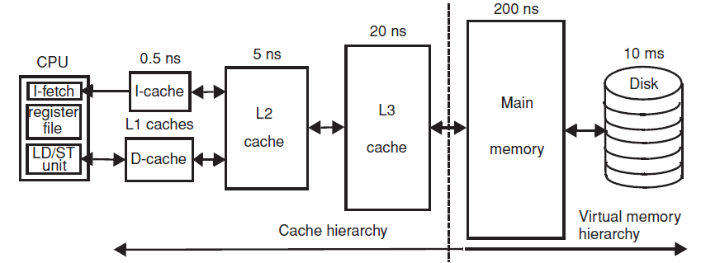
Typical Memory Hierarchy

Slide 12
CPU-Memory Bottleneck
Memory
CPU
Performance of high-speed computers is usually
limited by memory bandwidth & latency
Latency (time for a single access)
Memory access time >> Processor cycle time
Bandwidth (number of accesses per unit time)
Number of data channels
Clock speed of memory
Width of one channel

Slide 13
Physical Size Affects Latency
CPU
Big Memory
CPU
Small Memory
Signals have further to travel
Fan out to more locations

Slide 14
Memory Hierarchy
Big, Slow Memory
(DRAM)
A
Small,
Fast Memory
(RF, SRAM)
B
CPU
holds frequently used data
capacity: Register << SRAM << DRAM
latency: Register << SRAM << DRAM
bandwidth: on-chip >> off-chip
On a data access:
if data ∈ fast memory ⇒ low latency access (SRAM)
if data ∉ fast memory ⇒ long latency access (DRAM)
Notes:
Due to cost
Due to size of DRAM
Due to cost and wire delays (wires on-chip cost much less, and are faster)

Slide 15
In summary
Dynamic RAM (DRAM) is main form of main memory storage in use today
Holds values on small capacitors, need refreshing (hence dynamic)
Slow multi-step access: pre-charge, read row, read column
Static RAM (SRAM) is faster but more expensive
Used to build on-chip memory for caches
Cache holds small set of values in fast memory (SRAM) close to processor
Need to develop search scheme to find values in cache, and replacement policy to make space for newly accessed locations
Caches exploit two forms of predictability in memory reference streams
Temporal locality, same location likely to be accessed again soon
Spatial locality, neighboring location likely to be accessed soon

Slide 16
Contents
Memory
DRAM
Caches
Memory Management

Slide 17
Common Predictable Patterns
Two predictable properties of memory references:
Temporal Locality: If a location is referenced, it is likely to be referenced again soon
Spatial Locality: If a location is referenced it is likely that locations near it will be referenced soon (e.g., array access)
Notes:
The principle of locality states that programs access a relatively small portion of the address space at any instant of time.
This is kind of like in real life, we all have a lot of friends. But at any given time most of us can only keep in touch with a small group of them.
There are two different types of locality: Temporal and Spatial. Temporal locality is the locality in time which says if an item is referenced, it will tend to be referenced again soon.
This is like saying if you just talk to one of your friends, it is likely that you will talk to him or her again soon.
This makes sense. For example, if you just have lunch with a friend, you may say, let’s go to the ball game this Sunday. So you will talk to him again soon.
Spatial locality is the locality in space. It says if an item is referenced, items whose addresses are close by tend to be referenced soon.
Once again, using our analogy. We can usually divide our friends into groups. Like friends from high school, friends from work, friends from home.
Let’s say you just talk to one of your friends from high school and she may say something like: “So did you hear so and so just won the lottery.”
You probably will say NO, I better give him a call and find out more.
So this is an example of spatial locality. You just talked to a friend from your high school days. As a result, you end up talking to another high school friend. Or at least in this case, you hope he still remember you are his friend.
+3 = 10 min. (X:50)

Slide 18
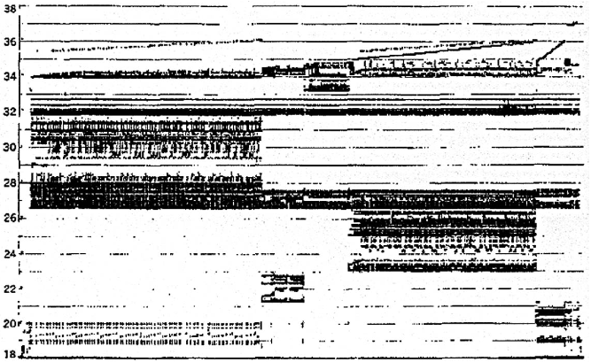
Memory Reference Patterns
Bad locality behavior
Temporal
Locality
Memory Address (one dot per access)
Spatial
Locality
Time
Source: Donald J. Hatfield, Jeanette Gerald: Program Restructuring for Virtual Memory. IBM Systems Journal 10(3): 168-192 (1971)

Slide 19
Caches
Caches exploit both types of predictability:
Exploit temporal locality by remembering the contents of recently accessed locations
Exploit spatial locality by fetching blocks of data around recently accessed locations

Slide 20
Cache Algorithm (Read)
Look at Processor Address, search cache tags to find match then either,
HIT - Found in Cache
MISS - Not in cache
Return copy
of data from
cache
Read block of data from Main Memory
Wait …
Return data to processor
and update cache
Hit Rate = fraction of accesses found in cache
Miss Rate = 1 – Hit rate
Hit Time = Cache access time +
time to determine HIT/MISS
Miss Time = time to replace block in cache +
time to deliver block to processor
Notes:
A HIT is when the data the processor wants to access is found in the upper level (Blk X).
The fraction of the memory access that are HIT is defined as HIT rate.
HIT Time is the time to access the Upper Level where the data is found (X). It consists of:
(a) Time to access this level.
(b) AND the time to determine if this is a Hit or Miss.
If the data the processor wants cannot be found in the Upper level. Then we have a miss and we need to retrieve the data (Blk Y) from the lower level.
By definition (definition of Hit: Fraction), the miss rate is just 1 minus the hit rate.
This miss penalty also consists of two parts:
(a) The time it takes to replace a block (Blk Y to BlkX) in the upper level.
(b) And then the time it takes to deliver this new block to the processor.
It is very important that your Hit Time to be much much smaller than your miss penalty. Otherwise, there will be no reason to build a memory hierarchy.
+2 = 14 min. (X:54)

Slide 21
Inside a Cache
Address
Address
Processor
CACHE
Main
Memory
Data
Data
copy of main
memory
location 100
copy of main
memory
location 101
100
Data
Byte
Data
Byte
Line
304
Data
Byte
Address
Tag
6848
416
Data Block

Slide 22
4 Questions for Memory Hierarchy
Q1: Where can a block be placed in the cache?
(Block placement)
Q2: How is a block found if it is in the cache? (Block identification)
Q3: Which block should be replaced on a miss? (Block replacement)
Q4: What happens on a write? (Write strategy)

Slide 23
Q1: Where can a block be placed?
Block Number
1 1 1 1 1 1 1 1 1 1 0 1 2 3 4 5 6 7 8 9
2 2 2 2 2 2 2 2 2 2 0 1 2 3 4 5 6 7 8 9
3 3
0 1
0 1 2 3 4 5 6 7 8 9
Memory
Set Number
0
0 1 2 3
0 1 2 3 4 5 6 7
Cache
Fully (2-way) Set Direct
Associative Associative Mapped
anywhere anywhere in only into
set 0 block 4
(12 mod 4) (12 mod 8)
Block 12
can be placed
Notes:
Simplest scheme is to extract bits from ‘block number’ to determine ‘set’ (jse)
More sophisticated schemes will hash the block number ---- why could that be good/bad?

Slide 24
Q2: How is a block found?
Index selects which set to look in
Tag on each block
No need to check index or block offset
Increasing associativity shrinks index, expands tag. Fully Associative caches have no index field.
Memory Address
Block Address
Block
Offset
Tag
Index

Slide 25
Direct-Mapped Cache
Tag
Index
Block
Offset
t
k
b
V
Tag
Data Block
2^{k}
lines
t
=
HIT
Data Word or Byte

Slide 26
2-Way Set-Associative Cache
Tag
Index
Block
Offset
b
t
k
V
Tag
Data Block
V
Tag
Data Block
t
=
=
Data
Word
or Byte
HIT

Slide 27
Fully Associative Cache
V
Tag
Data Block
t
=
Tag
t
=
HIT
Block
Offset
Data
Word
or Byte
=
b

Slide 28
What causes a MISS?
Three Major Categories of Cache Misses:
Compulsory Misses: first access to a block
Capacity Misses: cache cannot contain all blocks needed to execute the program
Conflict Misses: block replaced by another block and then later retrieved - (affects set assoc. or direct mapped caches)
Nightmare Scenario: ping pong effect!

Slide 29
Block Size and Spatial Locality
Block is unit of transfer between the cache and memory
4 words block, b=2
Tag
Word0
Word1
Word2
Word3
Split CPU address
block address offset_{b}
32-b bits
b bits
2^{b} = block size a.k.a line size (in bytes)
Larger block size has distinct hardware advantages
less tag overhead
exploit fast burst transfers from DRAM
exploit fast burst transfers over wide busses
What are the disadvantages of increasing block size?
Fewer blocks => more conflicts. Can waste bandwidth.
Notes:
Larger block size will reduce compulsory misses (first miss to a block).
Larger blocks may increase conflict misses since the number of blocks
is smaller.

Slide 30
Q3: Which block should be replaced on a miss?
Easy for Direct Mapped
Set Associative or Fully Associative:
Random
Least Recently Used (LRU)
LRU cache state must be updated on every access
true implementation only feasible for small sets (2-way)
pseudo-LRU binary tree often used for 4-8 way
First In, First Out (FIFO) a.k.a. Round-Robin
used in highly associative caches

Slide 31
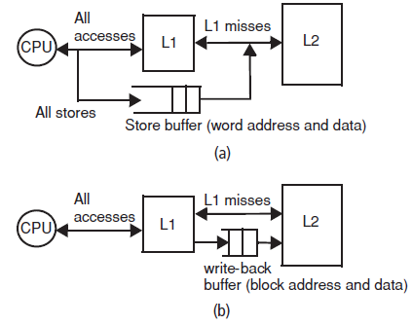
Write Through and Write Back Topologies

Slide 32
Q4: What happens on a write?
Cache hit:
write through: write both cache & memory
Generally, higher traffic for main memory, but simplifies cache coherence
A store buffer can retire store without exposing the processor to the access latency of lower-level cache
write back: write cache only (Memory is written only when the entry is evicted)
A dirty bit per block can further reduce the traffic
Cache miss:
no write allocate: only write to main memory
write allocate (aka fetch on write): fetch into cache
Common combinations:
write through and no write allocate
write back with write allocate

Slide 33
Write Policy Choices
Cache hit:
write through: write both cache & memory
Generally higher traffic but simpler pipeline & cache design
write back: write cache only, memory is written only when the entry is evicted
A dirty bit per block further reduces write-back traffic
Must handle 0, 1, or 2 accesses to memory for each load/store
Cache miss:
no write allocate: only write to main memory
write allocate (aka fetch on write): fetch into cache
Common combinations:
write through and no write allocate
write back with write allocate

Slide 34
5 Basic Cache Optimizations
Reducing Miss Rate
Larger Block size (compulsory misses are reduced but conflict misses are increased)
Larger Cache size (reduces capacity and conflict misses but increases hit time)
Higher Associativity (conflict misses are reduced but requires more comparators)
Reducing Miss Penalty
Multilevel Caches with inclusion
But can reduce available cache size for processor
Reducing hit time
Giving Reads Priority over the Writes
E.g., Read complete before earlier writes in write buffer

Slide 35
CPU-Cache Interaction (5-stage pipeline)
0x4
Add
E
Decode,
Register
Fetch
M
A
we
Y
addr
nop
ALU
Y
IR
B
Primary
Data
Cache
rdata
PC
addr
inst
D
R
wdata
hit?
hit?
wdata
PCen
Primary
Instruction
Cache
MD1
MD2
Stall entire CPU on data cache miss
To Memory Control
Cache Refill Data from Lower Levels of Memory Hierarchy
Notes:
How are writes to istream handled?

Slide 36
Improving Cache Performance
Average memory access time =
Hit time + Miss rate x Miss penalty
Example: 1 cycle (hit time)+(0.05)x(30)=2.5cycles!!
To improve performance:
reduce the hit time
reduce the miss rate
reduce the miss penalty
Hit time and miss rate are conflicting
What is the simplest design strategy?
Biggest cache that doesn’t increase hit time past 1-2 cycles (approx 8-32KB in modern technology)
[ design issues more complex with out-of-order superscalar processors ]
Notes:
Design the largest primary cache without slowing down the clock
Or adding pipeline stages.

Slide 37
Serial-versus-Parallel Cache and Memory access
α is HIT RATIO: Fraction of references in cache
1 - α is MISS RATIO: Remaining references
Addr
Addr
CACHE
Main
Memory
Processor
Data
Data
Average access time for serial search: t_{cache} + (1 - α) t_{mem}
Addr
CACHE
Main
Memory
Processor
Data
Data
Average access time for parallel search: α t_{cache} + (1 - α) t_{mem}
Savings are usually small, t_{mem} >> t_{cache}, hit ratio α high
High bandwidth required for memory path
Complexity of handling parallel paths can slow t_{cache}

Slide 38
Causes for Cache Misses
Compulsory: first-reference to a block a.k.a. cold start misses
- misses that would occur even with infinite cache
Capacity: cache is too small to hold all data needed by the program
- misses that would occur even under perfect
replacement policy
Conflict: misses that occur because of collisions
due to block-placement strategy
- misses that would not occur with full associativity

Slide 39
Effect of Cache Parameters on Performance (Review)
Larger cache size
reduces capacity and conflict misses
hit time will increase
Higher associativity
reduces conflict misses
may increase hit time
Larger block size
reduces compulsory and capacity (reload) misses
increases conflict misses and miss penalty
Notes:
Requested block first….
The following could be in the slide…
spatial locality reduces compulsory misses and capacity reload misses
fewer blocks may increase conflict miss rate
larger blocks may increase miss penalty

Slide 40
Write Performance
Tag
Index
Block
Offset
b
t
k
V
Tag
Data
2^{k}
lines
t
=
WE
HIT
Data Word or Byte
Notes:
Completely serial (jse)

Slide 41
Reducing Write Hit Time
Problem: Writes take two cycles in memory stage, one cycle for tag check plus one cycle for data write if hit
Solutions:
Fully-associative (CAM Tag) caches: Word line only enabled if hit
Pipelined writes: Hold write data for store in single buffer ahead of cache, write cache data during next store’s tag check
Notes:
Need to bypass from write buffer if read address matches write buffer tag!

Slide 42
Pipelining Cache Writes
Address and Store Data From CPU
Tag
Index
Store Data
Delayed Write Addr.
Delayed Write Data
Load/Store
=?
Tags
S
Data
L
=?
1
0
Load Data to CPU
Hit?
Data from a store hit written into data portion of cache during tag access of subsequent store

Slide 43
Write Buffer to Reduce Read Miss Penalty
Unified L2 Cache
Data Cache L1
CPU
Reg File
Write
buffer
Evicted dirty lines for write back cache
OR
All writes in write through cache
Processor is not stalled on writes, and read misses can go ahead of write to main memory
Problem: Write buffer may hold updated value of location needed by a read miss
Simple scheme: on a read miss, wait for the write buffer to go empty
Faster scheme: Check write buffer addresses against read miss addresses, if no match, allow read miss to go ahead of writes, else, return value in write buffer
Notes:
Deisgners of the MIPS M/1000 estimated that waiting for a four-word buffer to empty
increased the read miss penalty by a factor of 1.5.

Slide 44
Presence of L2 influences L1 design
Use smaller L1 if there is also L2
Trade increased L1 miss rate for reduced L1 hit time and reduced L1 miss penalty
Reduces average access energy
Use simpler write-through L1 with on-chip L2
Write-back L2 cache absorbs write traffic, doesn’t go off-chip
At most one L1 miss request per L1 access (no dirty victim write back) simplifies pipeline control
Simplifies coherence issues
Simplifies error recovery in L1 (can use just parity bits in L1 and reload from L2 when parity error detected on L1 read)

Slide 45
Inclusion Policy
Inclusive multilevel cache:
Inner cache holds copies of data in outer cache
If a block is brought at inner level cache it must be allocated at outer level cache as well
If a block is invalidated at inner level cache it must be removed at outer level cache as well
External coherence snoop access need only check outer cache
Exclusive multilevel caches:
Inner cache may hold data not in outer cache
Swap lines between inner/outer caches on miss
Victim is written in L2
Used in AMD Athlon with 64KB primary and 256KB secondary cache
Why choose one type or the other?
Notes:
New slide (jse)

Slide 46
Reduce miss penalty of long blocks
Do not wait for full block before restarting the CPU
Early restart
Critical word first

Slide 47
Non-blocking Caches
Blocking cache
one processor access at a time
Suitable for 5 stage pipeline
Not suitable for a machine that can execute multiple memory accesses in one cycle
Increase cache bandwidth with non blocking caches
Overlapping cache accesses
Non-blocking caches are used in
Modern wide-issue Out of Order processors because
Memory access throughput must be sustained
Memory accesses must execute concurrently
To hide the large penalty of cache misses

Slide 48
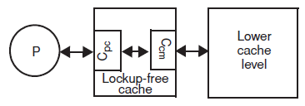
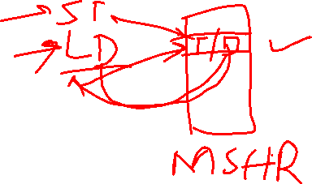
Non-blocking caches
A miss in cache is allocated in
Miss Status Handling Register (MSHR)
MSHR has information
Cache line allocated to miss
Block address
Destination register of load
Overlapped miss requests to same block are allowed
Primary miss
Secondary miss
Intel Pentium Pro supports four outstanding memory misses

Slide 49
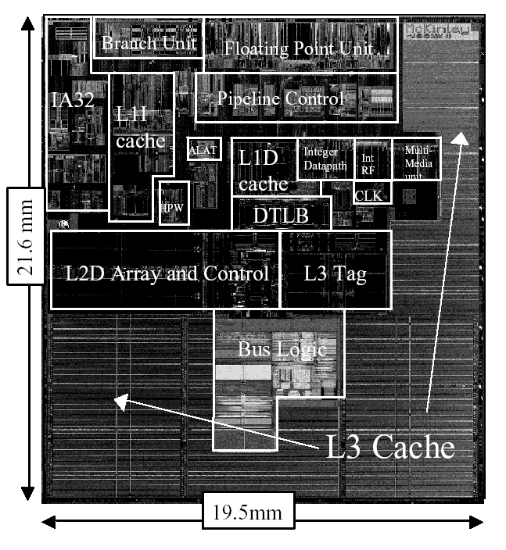
Itanium-2 On-Chip Caches (Intel/HP, 2002)
Level 1: 16KB, 4-way s.a., 64B line, quad-port (2 load+2 store), single cycle latency
Level 2: 256KB, 4-way s.a, 128B line, quad-port (4 load or 4 store), five cycle latency
Level 3: 3MB, 12-way s.a., 128B line, single 32B port, twelve cycle latency
Notes:
If two is good, then three must be better (jse)

Slide 50
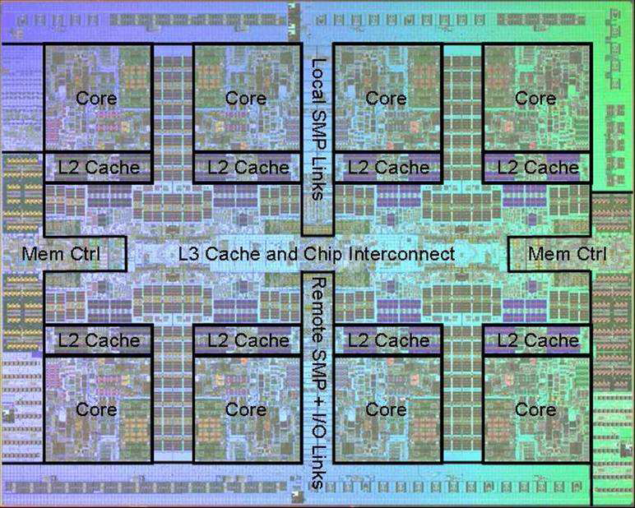
Power 7 On-Chip Caches [IBM 2009]
32KB L1 I$/core
32KB L1 D$/core
3-cycle latency
256KB Unified L2$/core
8-cycle latency
32MB Unified Shared L3$
Embedded DRAM
25-cycle latency to local slice

Slide 51
Prefetching
Speculate on future instruction and data accesses and fetch them into cache(s)
Instruction accesses easier to predict than data accesses
Varieties of prefetching
Hardware prefetching
Software prefetching
Mixed schemes
What types of misses does prefetching affect?
Notes:
Reduces compulsory misses, can increase conflict and
capacity misses.

Slide 52
Issues in Prefetching
Usefulness – should produce hits
Timeliness – not late and not too early
Cache and bandwidth pollution
L1 Instruction
Unified L2 Cache
CPU
L1 Data
RF
Prefetched data

Slide 53
Hardware Instruction Prefetching
Instruction prefetch in Alpha AXP 21064
Fetch two blocks on a miss; the requested block (i) and the next consecutive block (i+1)
Requested block placed in cache, and next block in instruction stream buffer
If miss in cache but hit in stream buffer, move stream buffer block into cache and prefetch next block (i+2)
Prefetched
instruction block
Req
block
Stream
Buffer
CPU
Unified L2 Cache
L1 Instruction
RF
Req
block
Notes:
Need to check the stream buffer if the requested block is in there.
Never more than one 32-byte block in the stream buffer.

Slide 54
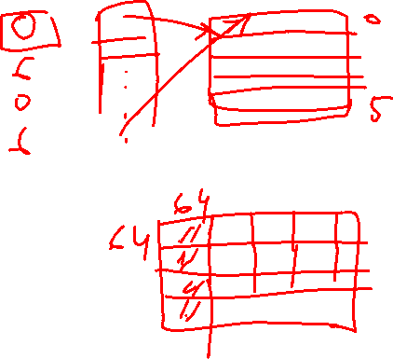
Hardware Data Prefetching
Prefetch-on-miss:
Prefetch b + 1 upon miss on b
One Block Lookahead (OBL) scheme
Initiate prefetch for block b + 1 when block b is accessed
Why is this different from doubling block size?
Can extend to N-block look-ahead
Strided prefetch
If observe sequence of accesses to block b, b+N, b+2N, then prefetch b+3N etc.
Example: IBM Power 5 [2003] supports eight independent streams of strided prefetch per processor, prefetching 12 lines ahead of current access
Notes:
HP PA 7200 uses OBL prefetching
Tag prefetching is twice as effective as prefetch-on-miss in
reducing miss rates.

Slide 55
Software Prefetching
for(i=0; i < N; i++) { prefetch( &a[i + 1] ); prefetch( &b[i + 1] ); SUM = SUM + a[i] * b[i]; }
Notes:
Cache should be non-blocking or lockup-free.
By that we mean that the processor can proceed while the prefetched
Data is being fetched; and the caches continue to supply instructions
And data while waiting for the prefetched data to return.

Slide 56

Software Prefetching Issues
Timing is the biggest issue, not predictability
If you prefetch very close to when the data is required, you might be too late
Prefetch too early, cause pollution
Estimate how long it will take for the data to come into L1, so we can set P appropriately
Why is this hard to do?
for(i=0; i < N; i++) { prefetch( &a[i + P] ); prefetch( &b[i + P] ); SUM = SUM + a[i] * b[i]; }
Must consider cost of prefetch instructions

Slide 57
Contents
Memory
DRAM
Caches
Memory Management

Slide 58
Memory Management

Slide 59
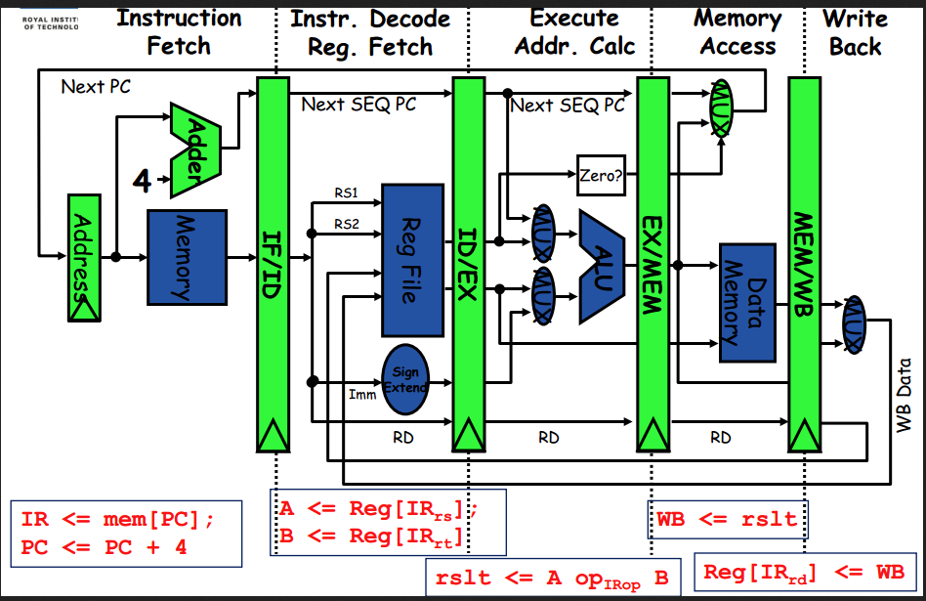
Bare Machine

Slide 60
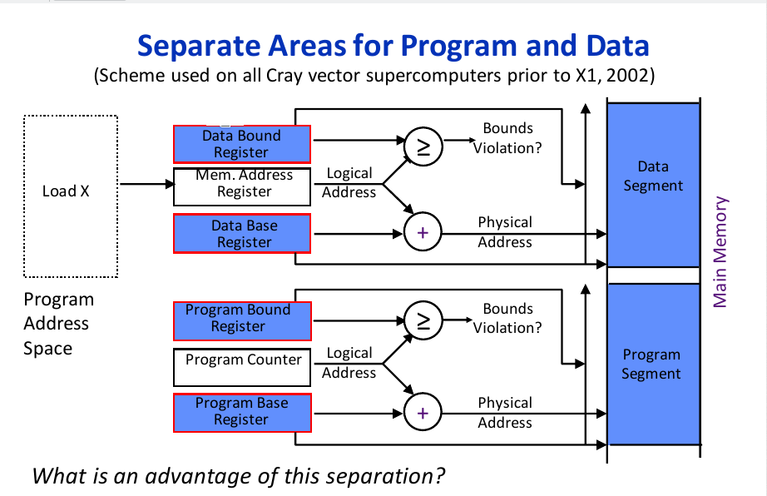
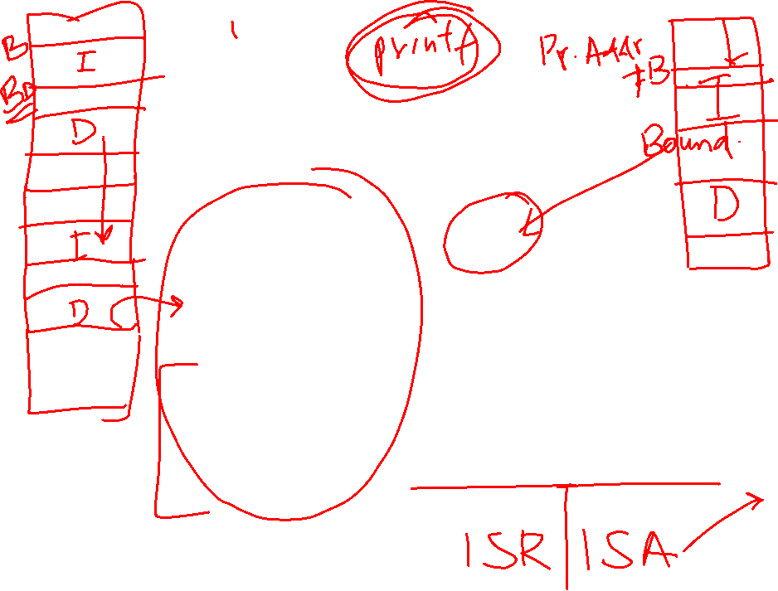
Base and Bound Scheme

Slide 61
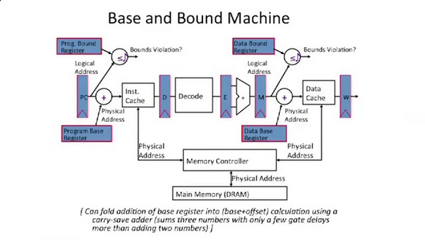
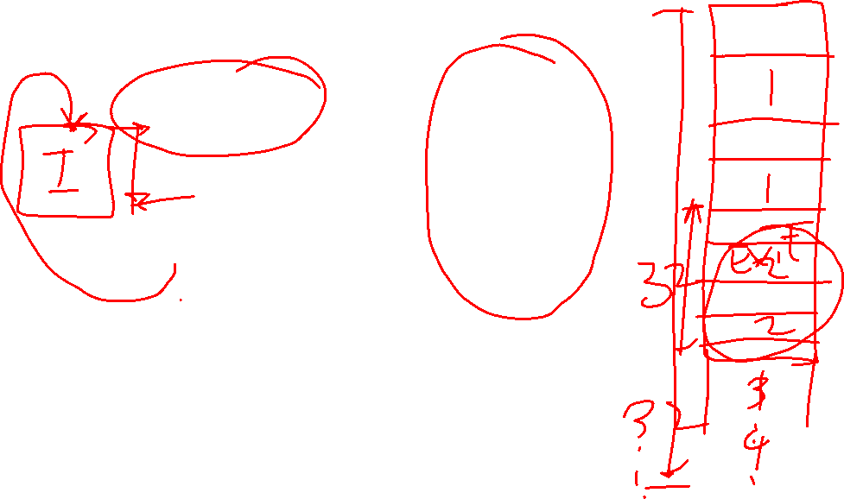
Base and Bound Scheme

Slide 62
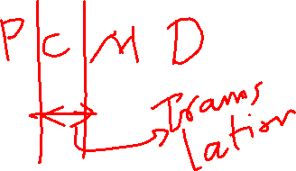
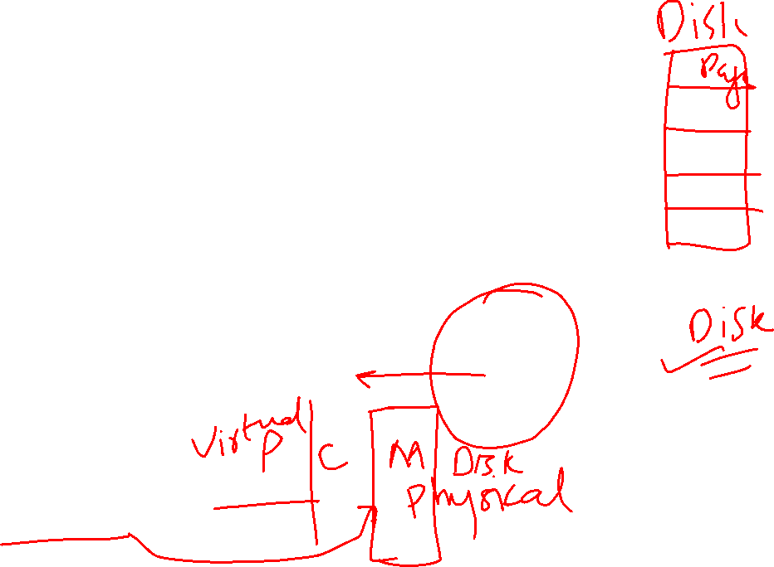
Modern Virtual Memory Systems Illusion of a large, private, uniform store
Protection & Privacy
several users, each with their private address space and one or more shared address spaces
page table ≡ name space
Demand Paging
Provides the ability to run programs larger than the primary memory
Hides differences in machine configurations
The price is the address translation on each memory reference
OS
user_{i}
Swapping
Store
Primary
Memory
VA
mapping
PA
TLB
Notes:
Portability on machines with different memory configurations.

Slide 63
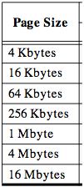
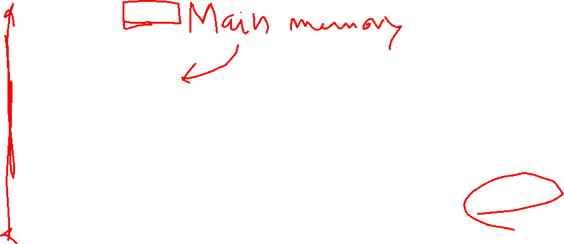
Page tables encode virtual address spaces
A virtual address space
is divided into blocks
of memory called pages
Virtual
Address Space
Physical
Address Space
frame
frame
A machine usually supports
pages of a few sizes
(MIPS R4000):
frame
frame
A valid page table entry codes physical memory “frame” address for the page

Slide 64
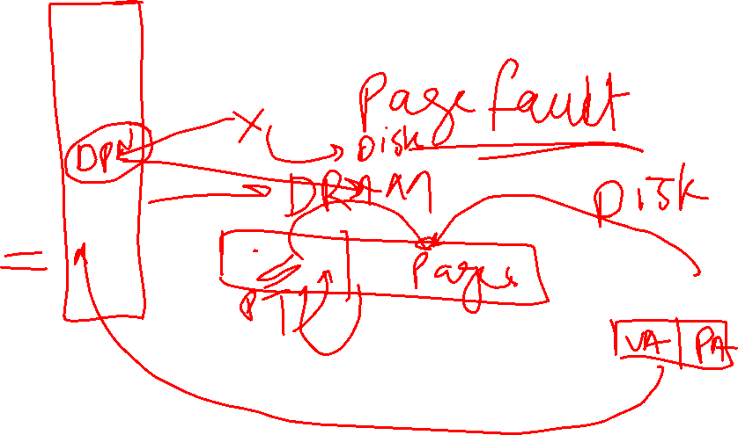
Page tables encode virtual address spaces
Page Table
Physical
Memory Space
A virtual address space
is divided into blocks
of memory called pages
frame
frame
frame
frame
A machine usually supports
pages of a few sizes
(MIPS R4000):
virtual address
OS manages the page table for each process
A page table is indexed by a
virtual address
A valid page table entry codes physical memory “frame” address for the page

Slide 65
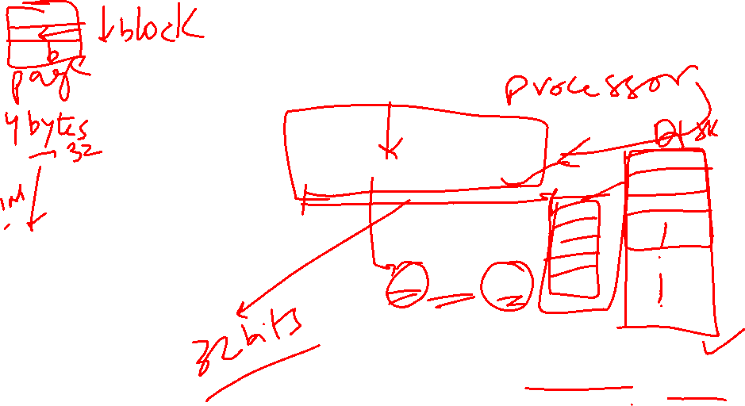
Details of Page Table
Page Table
Physical
Memory Space
Virtual Address
frame
12
frame
V page no.
offset
frame
frame
Page Table
Page Table
Base Reg
V
Access
Rights
PA
index
into
page
table
virtual address
table located
in physical
memory
P page no.
offset
12
Physical Address
Page table maps virtual page numbers to physical frames (“PTE” = Page Table Entry)
Virtual memory => treat memory ≈ cache for disk

Slide 66
VM and Disk: Page replacement policy
Page Table
Dirty bit: page written.
Used bit: set to
1 on any reference
dirty
used
1 0
...
1 0
0 1
1 1
0 0
Set of all pages
in Memory
Tail pointer:
Clear the used
bit in the
page table
Head pointer
Place pages on free list if used bit
is still clear.
Schedule pages with dirty bit set to
be written to disk.
Freelist
Architect’s role: support setting dirty and used bits
Free Pages

Slide 67
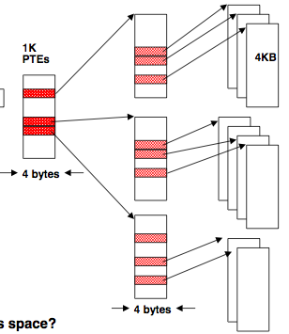
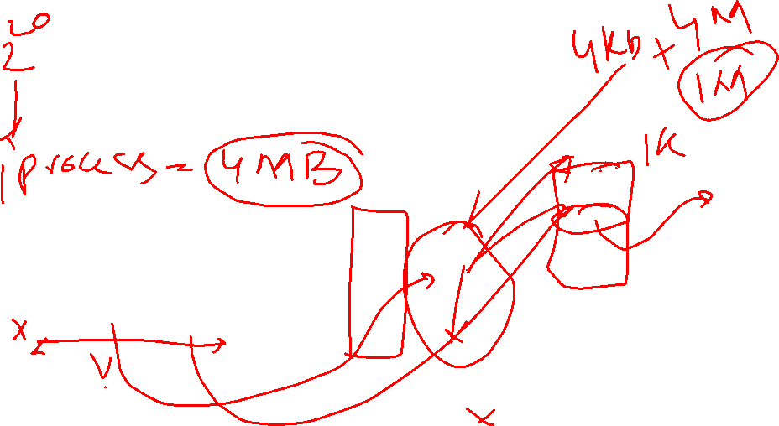
Page tables may not fit in memory!
A table for 4KB pages for a 32-bit address space has 1M entries
Each process needs its own address space!
Two-level Page Tables
32-bit virtual address
31
22
21
12
11
0
P1 index
P2 index
Page Offset
Top-level table wired in main memory
Subset of 1024 second-level tables in main memory; rest are on disk or unallocated

Slide 68
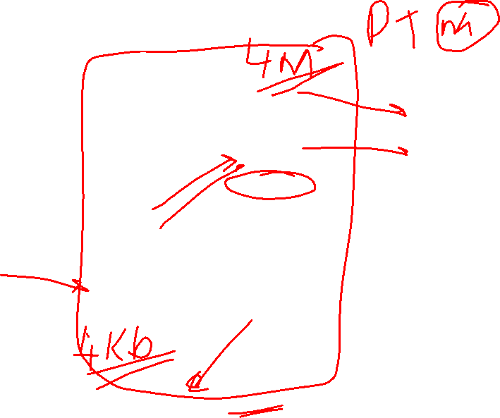
Hierarchical Page Table
Virtual Address
31
22
21
12
11
0
p1 p2 offset
10-bit
L1 index
10-bit
L2 index
offset
Root of the Current
Page Table
p2
p1
Physical Memory
(Processor
Register)
Level 1
Page Table
Level 2
Page Tables
page in primary memory
page in secondary memory
PTE of a nonexistent page
Data Pages

Slide 69
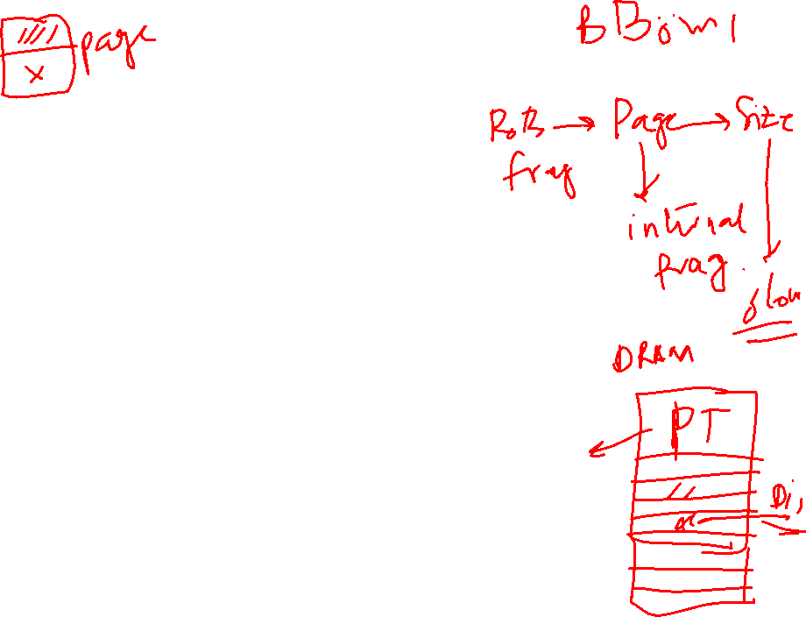
Inverted Page Table
Hierarchical page table
Each process has its own set of page tables
A lot of page table entries are still empty
Inverted page tables
Inverted page table has one entry per physical page frame
That it is shared by all processes
Motivation
There cannot be more valid page-table entries than there are page frames
Size of page table
Proportional to number of page frames
Not to number of pages
Shared by all processes
Virtual page number is hashed to obtain one entry in inverted page table

Slide 70
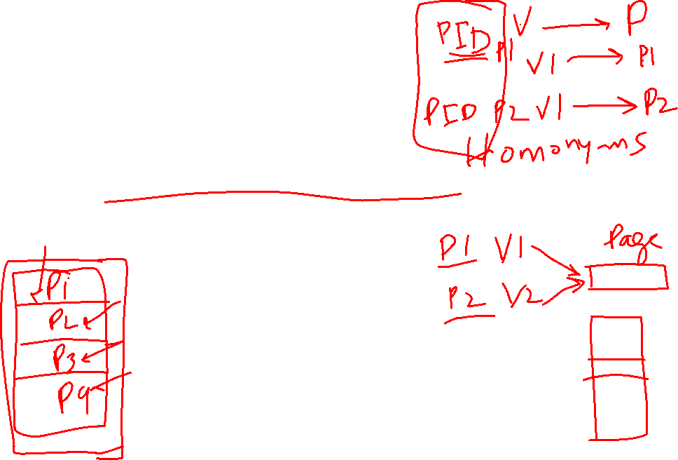
Inverted Page Table
Synonyms
Solved since page table is shared
All processes refer to same page with same VA
Per process access rights
Solved by memory segmentation
Each VA points to a memory segment private to a process
But segments are paged in a unique virtual space shared by all processes

Slide 71
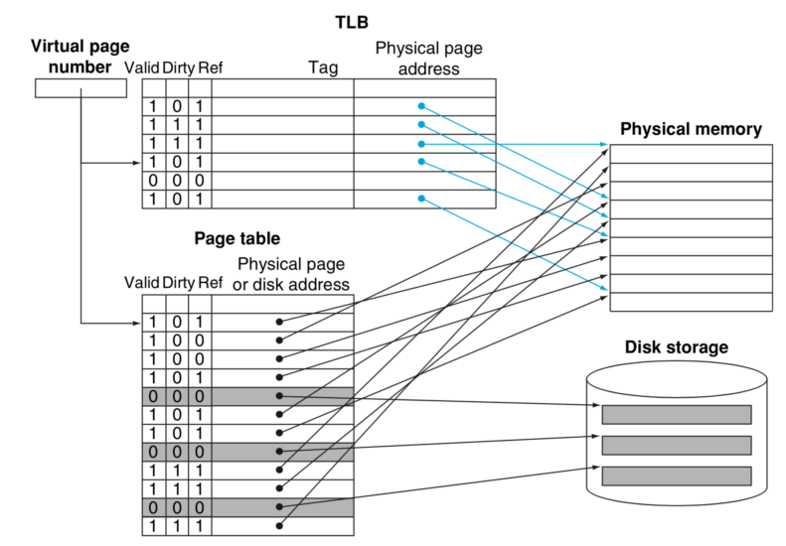
Translation Lookaside Buffer

Slide 72
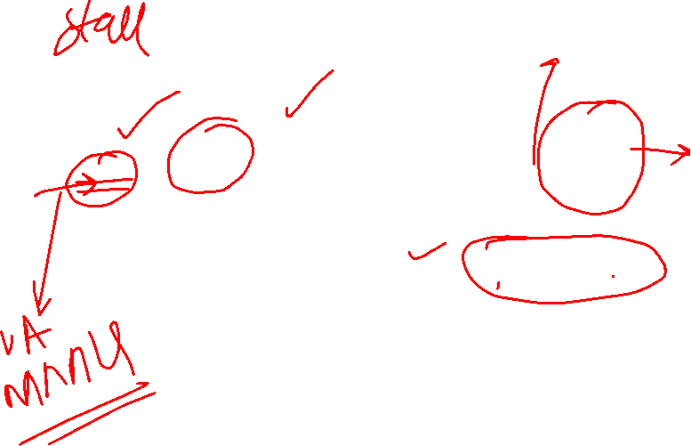
Page-Based Virtual-Memory Machine (Hardware Page-Table Walk)
Page Fault?
Protection violation?
Page Fault?
Protection violation?
Virtual Address
Virtual Address
Physical Address
Physical Address
PC
Inst. TLB
D
Decode
E
M
Data TLB
W
Inst. Cache
Data Cache
+
Miss?
Miss?
Page-Table Base Register
Hardware Page Table Walker
Physical Address
Memory Controller
Physical Address
Physical Address
Main Memory (DRAM)
Assumes page tables held in un-translated physical memory

Slide 73

Address Translation: putting it all together
Virtual Address
hardware
hardware or software
software
Restart instruction
TLB
Lookup
miss
hit
Page Table
Walk
Protection
Check
the page is
∉ memory ∈ memory
denied
permitted
Page Fault
(OS loads page)
Update TLB
Protection
Fault
Physical
Address
(to cache)
SEGFAULT
Notes:
Need to restart instruction.
Soft and hard page faults.

Slide 74
Page Fault Handler
When the referenced page is not in DRAM:
The missing page is located (or created)
It is brought in from disk, and page table is updated
Another job may be run on the CPU while the first job waits for the requested page to be read from disk
If no free pages are left, a page is swapped out
Pseudo-LRU replacement policy
Since it takes a long time to transfer a page (msecs), page faults are handled completely in software by the OS
Untranslated addressing mode is essential to allow kernel to access page tables

Slide 75
Handling VM-related exceptions
PC
Inst TLB
Inst. Cache
D
Decode
E
M
Data TLB
Data Cache
W
+
TLB miss? Page Fault?
Protection violation?
TLB miss? Page Fault?
Protection violation?
Handling a TLB miss needs a hardware or software mechanism to refill TLB
Handling a page fault (e.g., page is on disk) needs a restartable exception so software handler can resume after retrieving page
Precise exceptions are easy to restart
Can be imprecise but restartable, but this complicates OS software
Handling protection violation may abort process
But often handled the same as a page fault

Slide 76

Address Translation in CPU Pipeline
PC
Inst TLB
Inst. Cache
D
Decode
E
M
Data TLB
Data Cache
W
+
TLB miss? Page Fault?
Protection violation?
TLB miss? Page Fault?
Protection violation?
Need to cope with additional latency of TLB:
slow down the clock?
pipeline the TLB and cache access?
virtual address caches
parallel TLB/cache access

Slide 77
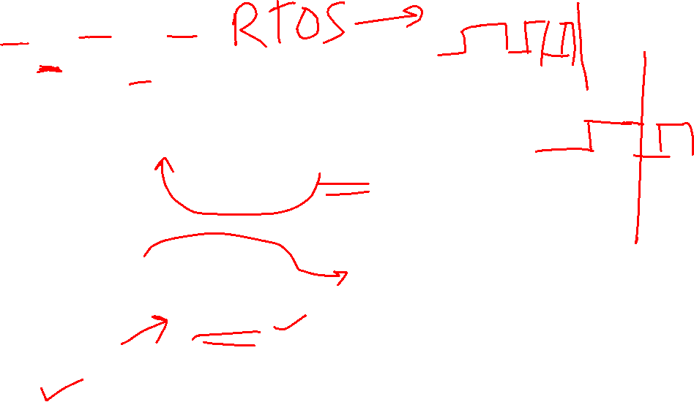
Virtual-Address Caches
PA
VA
Physical
Cache
Primary
Memory
CPU
TLB
Alternative: place the cache before the TLB
VA
Primary
Memory
CPU
Virtual
Cache
PA
(StrongARM)
TLB
one-step process in case of a hit (+)
cache needs to be flushed on a context switch unless address space identifiers (ASIDs) included in tags (-)
aliasing problems due to the sharing of pages (-)
maintaining cache coherence (-) (see later in course)

Slide 78

Virtually Addressed Cache (Virtual Index/Virtual Tag)
Virtual Address
Virtual Address
PC
D
Decode
E
M
W
Inst. Cache
Data Cache
+
Miss?
Miss?
Inst. TLB
Page-Table Base Register
Hardware Page Table Walker
Data TLB
Physical Address
Physical Address
Memory Controller
Instruction / data
Physical Address
Main Memory (DRAM)
Translate on miss

Slide 79
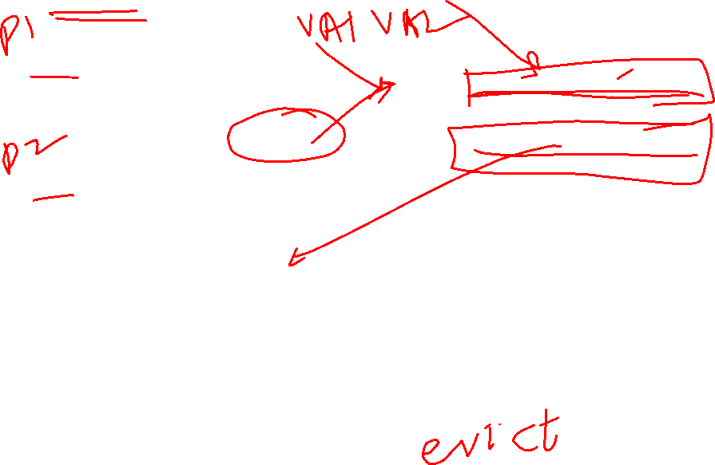
Aliasing in Virtual-Address Caches
Page Table
Tag
Data
VA₁
Data Pages
VA₁
1st Copy of Data at PA
PA
VA₂
2nd Copy of Data at PA
VA₂
Virtual cache can have two copies of same physical data. Writes to one copy not visible to reads of other!
Two virtual pages share one physical page
General Solution: Prevent aliases coexisting in cache
Software (i.e., OS) solution for direct-mapped cache
VAs of shared pages must agree in cache index bits; this ensures all VAs accessing same PA will conflict in direct-mapped cache (early SPARCs)
Notes:
Two processes sharing the same file,
Map the same memory segment to different
Parts of their address space.

Slide 80
Concurrent Access to TLB & Large L1 The problem with L1 > Page size
Virtual Index
L1 PA cache
Direct-map
VA
VPN a Page Offset b
TLB
VA₁
PPN_{a} Data
VA₂
PPN_{a} Data
PA
PPN Page Offset b
=
hit?
Tag
Can VA₁ and VA₂ both map to PA ?
Notes:
If they differ in the lower ‘a’ bits alone, and share a physical page.

Slide 81
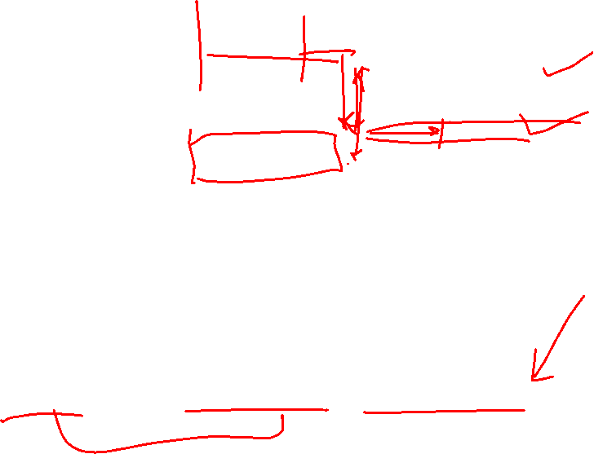
Concurrent Access to TLB & Cache (Virtual Index/Physical Tag)
Virtual
Index
VA
VPN L b
TLB
Direct-map Cache
2^{L} blocks
2^{b}-byte block
k
PA
PPN Page Offset
Tag
=
Physical Tag
Data
hit?
Index L is available without consulting the TLB
⇒ Cache and TLB accesses can begin simultaneously!
Tag comparison is made after both accesses are completed
Cases: L + b = k, L + b < k, L + b > k

Slide 82
Virtual-Index Physical-Tag Caches: Associative Organization
Virtual
Index
VA
VPN a L = k-b b
2ª
TLB
Direct-map
2^{L} blocks
Direct-map
2^{L} blocks
k
Phy.
Tag
PA
PPN Page Offset
=
=
Tag
hit?
2ª
Data
After the PPN is known, 2ª physical tags are compared
How does this scheme scale to larger caches?
Notes:
Consider 4-Kbyte pages and caches with 32-byte blocks
32-Kbyte cache ⇒ 2ª = 8
4-Mbyte cache ⇒ 2ª =1024 No !

Slide 83

A solution via Second Level Cache
CPU
L1 Instruction Cache
Unified L2 Cache
Memory
Memory
L1 Data Cache
Memory
RF
Memory
Usually, a common L2 cache backs up both Instruction and Data L1 caches
L2 is “inclusive” of both Instruction and Data caches
Inclusive means L2 has copy of any line in either L1

Slide 84
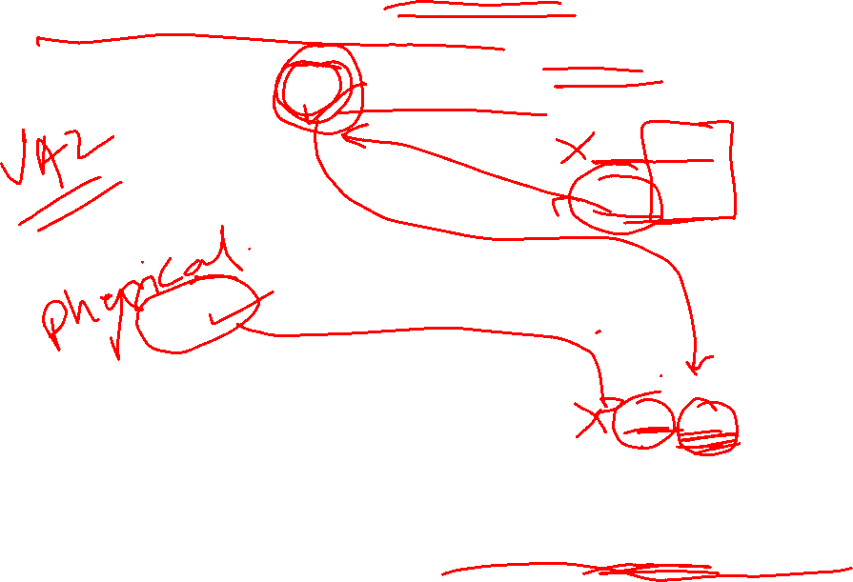
Anti-Aliasing Using L2: MIPS R10000
Virtual Index
L1 PA cache
Direct-map
VA
VPN a Page Offset b
into L2 tag
VA₁
PPN_{a} Data
TLB
VA₂
PPN_{a} Data
PA
PPN Page Offset b
PPN
=
hit?
Tag
Suppose VA1 and VA2 both map to PA and VA1 is already in L1, L2 (VA1 ≠ VA2)
After VA2 is resolved to PA, a collision will be detected in L2.
VA1 will be purged from L1 and L2, and VA2 will be loaded ⇒ no aliasing !
PA a₁ Data
Direct-Mapped L2
Virtual index physical tag L1 & L2 caches

Slide 85
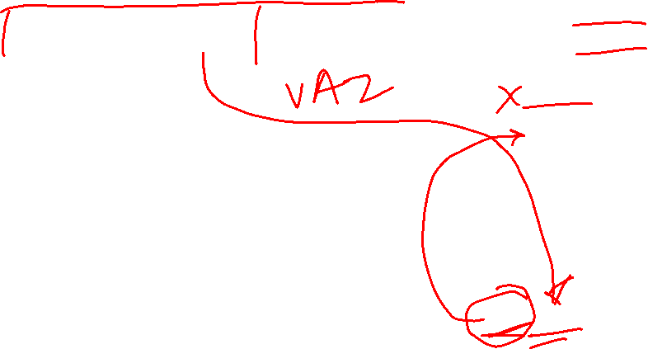
Anti-Aliasing using L2 for a Virtually Addressed L1
Virtual
Index & Tag
VA
VPN Page Offset b
TLB
VA₁ Data
VA₂ Data
PA
PPN Page Offset b
L1 VA Cache
“Virtual
Tag”
Tag
Physical
Index & Tag
PA VA₁ Data
Physically-addressed L2 can also be used to avoid aliases in virtually-addressed L1
L2 PA Cache
L2 “contains” L1

Slide 86
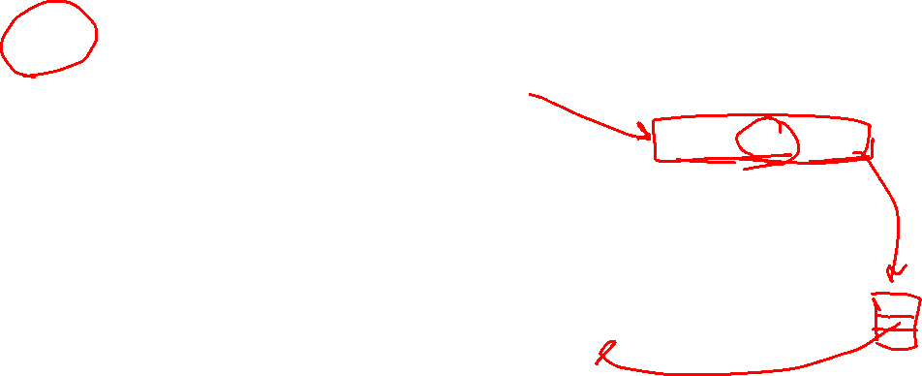
Hashed Page Table: Approximating Associative Addressing
VPN d
Virtual Address
Page Table
Offset
+
PA of PTE
PID
hash
Base of Table
VPN PID PPN
Hashed Page Table is typically 2 to 3 times larger than the number of PPN’s to reduce collision probability
It can also contain DPN’s for some non-resident pages (not common)
If a translation cannot be resolved in this table then the software consults a data structure that has an entry for every existing page (e.g., full page table)
VPN PID DPN
VPN PID
Primary
Memory

Slide 87
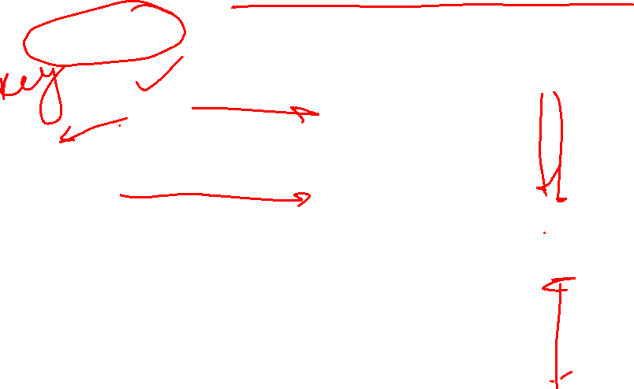
Power PC: Hashed Page Table
VPN d
80-bit VA
Page Table
Offset
+
PA of Slot
hash
VPN PPN
VPN
Base of Table
Each hash table slot has 8 PTE's <VPN,PPN> that are searched sequentially
If the first hash slot fails, an alternate hash function is used to look in another slot
All these steps are done in hardware!
Hashed Table is typically 2 to 3 times larger than the number of physical pages
The full backup Page Table is a software data structure
Primary
Memory

Slide 88
VM features track historical uses:
Bare machine, only physical addresses
One program owned entire machine
Batch-style multiprogramming
Several programs sharing CPU while waiting for I/O
Base & bound: translation and protection between programs (not virtual memory)
Problem with external fragmentation (holes in memory), needed occasional memory defragmentation as new jobs arrived
Time sharing
More interactive programs, waiting for user. Also, more jobs/second.
Motivated move to fixed-size page translation and protection, no external fragmentation (but now internal fragmentation, wasted bytes in page)
Motivated adoption of virtual memory to allow more jobs to share limited physical memory resources while holding working set in memory
Virtual Machine Monitors
Run multiple operating systems on one machine
Idea from 1970s IBM mainframes, now common on laptops
e.g., run Windows on top of Mac OS X
Hardware support for two levels of translation/protection
Guest OS virtual -> Guest OS physical -> Host machine physical

Slide 89
Virtual Memory Use Today - 1
Servers/desktops/laptops/smartphones have full demand-paged virtual memory
Portability between machines with different memory sizes
Protection between multiple users or multiple tasks
Share small physical memory among active tasks
Simplifies implementation of some OS features
Vector supercomputers have translation and protection but rarely complete demand-paging
(Older Crays: base&bound, Japanese & Cray X1/X2: pages)
Don’t waste expensive CPU time thrashing to disk (make jobs fit in memory)
Mostly run in batch mode (run set of jobs that fits in memory)
Difficult to implement restartable vector instructions

Slide 90
Next Lecture
Chip multiprocessors

